Slide 1
MySQL INTERNSHIP
Task 2 Paytm epurchase Analysis

Slide 2
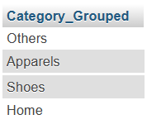
What does the "Category_Grouped" column represent, and how many unique categories are there?
select distinct(Category_Grouped) from paytm_epurchase;

Slide 3
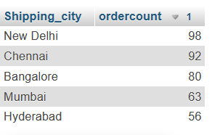
2. Can you list the top 5 shipping cities in terms of the number of orders?
select temp.Shipping_city, temp.ordercount from (select Shipping_city,count(Item_NM)as ordercount from paytm_epurchase group by Shipping_city) temp order by temp.ordercount desc limit 5;

Slide 4
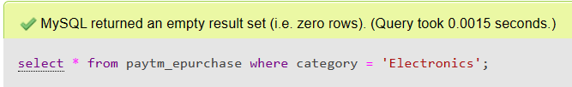
3. Show me a table with all the data for products that belong to the "Electronics" category.
select * from paytm_epurchase where category = 'Electronics’;

Slide 5
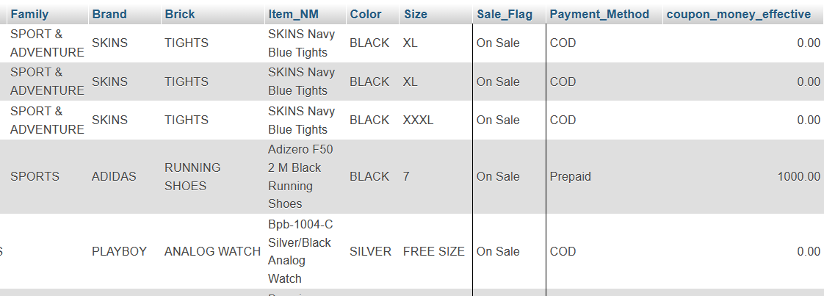
4. Filter the data to show only rows with a "Sale_Flag" of 'Yes’
select * from paytm_epurchase where Sale_Flag = 'on sale’;

Slide 6
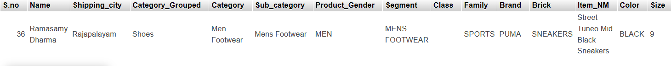
5. Sort the data by "Item_Price" in descending order. What is the most expensive item?
select * from paytm_epurchase order by Item_Price desc limit 1;

Slide 7
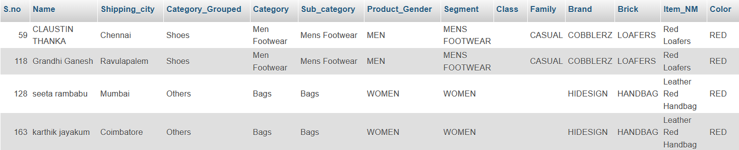
6. Apply conditional formatting to highlight all products with a "Special_Price_effective"
value below $50 in red.
select *,if(Special_Price_effective < 50 , 'Yes','no') from paytm_epurchase where color = 'red';

Slide 8
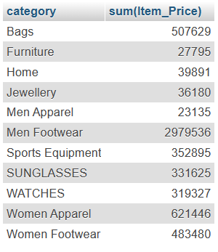
7. Create a pivot table to find the total sales value for each category.
select category,sum(Item_Price)from paytm_epurchase group by category;

Slide 9
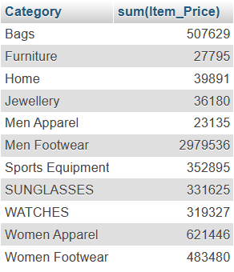
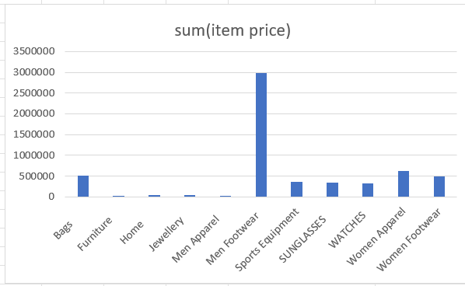
8. Create a bar chart to visualize the total sales for each category
select Category,sum(Item_Price) from paytm_epurchase group by Category;

Slide 10
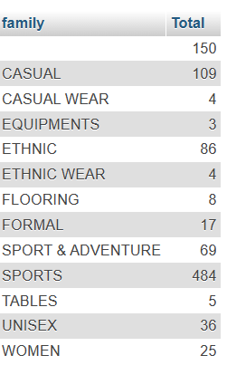
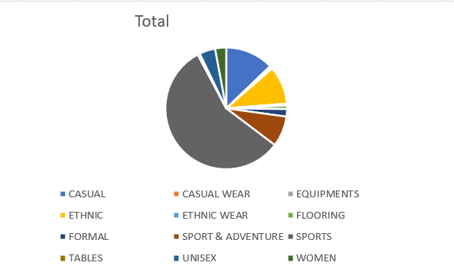
9. Create a pie chart to show the distribution of products in the "Family" category.
select family,count(*) As Total from paytm_epurchase group by family;

Slide 11

10. Ensure that the "Payment_Method" column only contains valid payment methods (e.g., Visa, MasterCard).
select * from paytm_epurchase where Payment_Method in('visa','Mastercard');

Slide 12

11. Calculate the average "Quantity" sold for products in the "Clothing" category, grouped
by "Product_Gender.“
select Product_Gender,avg(Quantity) from paytm_epurchase
where Segment in ('MENS WEAR','WOMENS WEAR’)
group by Product_Gender;

Slide 13
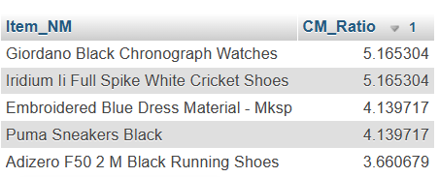
12. Find the top 5 products with the highest "Value_CM1" and "Value_CM2" ratios. Create a
chart to visualize this data.
Select distinct Item_NM, Value_CM1 / Value_CM2 AS CM_Ratio from paytm_epurchase order by CM_Ratio desc limit 5;

Slide 14
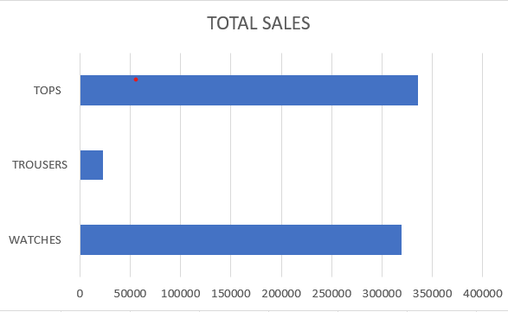
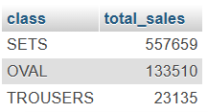
13. Identify the top 3 "Class" categories with the highest total sales. Create a stacked bar
chart to represent this data.
select class, sum(item_price) as total_sales from paytm_epurchase
group by class
order by item_price desc limit 3;

Slide 15
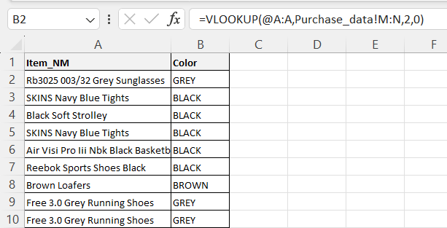
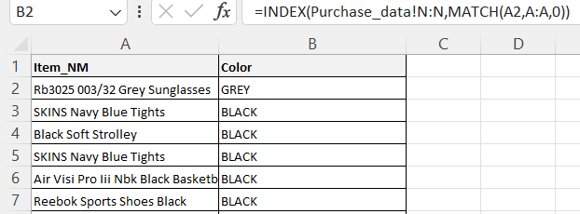
14. Use VLOOKUP or INDEX-MATCH to retrieve the "Color" of a product with a specific "Item_NM."

Slide 16

15. Calculate the total "coupon_money_effective" and "Coupon_Percentage" for products in
the "Electronics" category.
select category, sum(coupon_money_effective),
sum(Coupon_Percentage) from paytm_epurchase
where category = 'Electronics';

Slide 17
16. Perform a time series analysis to identify the month with the highest total sales.
There is no sufficient data to perform the above query

Slide 18
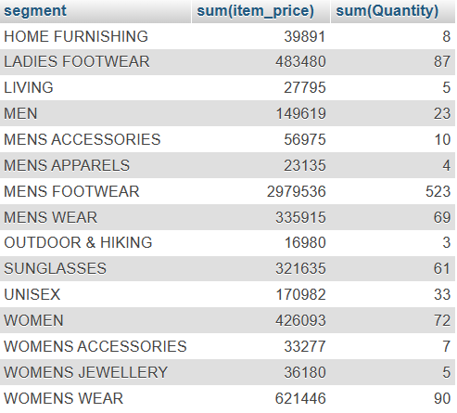
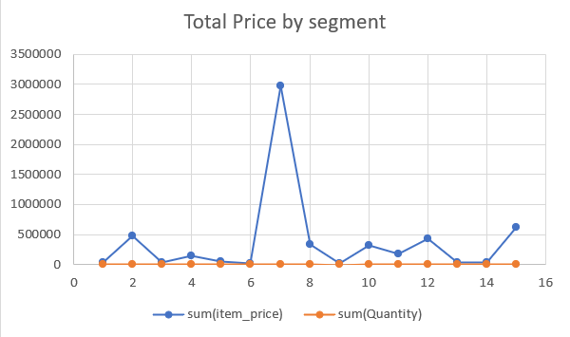
17. Calculate the total sales for each "Segment" and create a scatter plot to visualize the
relationship between "Item_Price" and "Quantity" in this data.
select segment, sum(item_price),sum(Quantity) from paytm_epurchase group by segment;

Slide 19

18. Use the AVERAGEIFS function to find the average "Item_Price" for products that have a
"Sale_Flag" of 'Yes.’
select avg(item_price) As Average from paytm_epurchase where sale_flag='on sale';

Slide 20
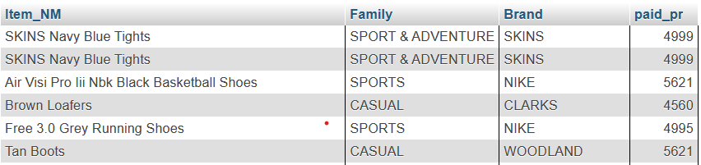
19. Identify products with a "Paid_pr" higher than the average in their respective "Family"
and "Brand" groups.
select paytm_epurchase.Item_NM,paytm_epurchase.Family,paytm_epurchase.Brand,
paytm_epurchase.paid_pr from (select Family,Brand, avg(Paid_pr) as avg_pr from paytm_epurchase group by Family,Brand)temp , paytm_epurchase where temp.Family = paytm_epurchase.Family and temp.Brand = paytm_epurchase.Brand and temp.avg_pr < paytm_epurchase.paid_pr;

Slide 21

20. Create a pivot table to show the total sales for each "Color" within the "Clothing"
category and use conditional formatting to highlight the highest sales.
select category, color from paytm_epurchase where category = ‘Clothing' group by color;

Slide 22
Thank You

